Slide 1
ABM Version 1

Slide 2
OVERVIEW OF ABM - Part 1: Calibration and Validation
L5
L5
L5
Mothers with complications
Mothers with complications
Mothers with complications
L4
L4
L4
L2/L3
L2/L3
L2/L3
Transferred mothers
Transferred mothers
Home
Home
Home
1. Mothers’ initial choice of delivery
2. Subset of mothers with complications
3. Mothers with complications transferred
4. Health outcomes for all mothers

Slide 3
MOTHER’S INITIAL CHOICE OF DELIVERY FACILITY
L5
17377 (26%)
Aggregated from received facility data to the facility levels
Percentage of home births is approximated according to Nimako et al. 2018:
35% of births are at home
L4
20636 (31%)
L2/L3
5125
(8%)
Home
23228 (35%)
1. Mothers’ initial choice of delivery

Slide 4
SUBSET OF MOTHERS WITH COMPLICATIONS
L5
9.5%
Aggregated from received facility data to the facility levels
Percentage of complications at home is assumed to be the same as the overall percentage of complications across facilities (3.5%)
The complication rates are assumed to be final complication rates post transfer of mothers across facilities.
Mothers with complications
L4
3.8%
L2/L3
1.3%
Home
3.5%
2. Subset of mothers with complications

Slide 5
MOTHERS WITH COMPLICATIONS TRANSFERRED AND NOT TRANSFERRED
L5
9.5%
0.9%
2.6%
3.9%
2.2%
Mothers with complications
L4
3.8%
0.5%
2.1%
0.4%
1.3%
=
+
+
+
L2/L3
1.4%
0.0%
1.3%
0.0%
0.3%
Transferred mothers
Home
3.5%
0.6%
2.2%
high
low
high
low
2. Subset of mothers with complications
Not transferred
Transferred into

Slide 6
MOTHERS WITH COMPLICATIONS TRANSFERRED: Example of home transfers
Home
3.5%
← We assume 3.5% complications at home equal to overall complication rate across all facility levels.
?
?
L5
L5
?
L4
L4
?
L2/L3
?
L2/L3
?
Home
Home
low-severity
high-severity
complication transfers

Slide 7
MOTHERS WITH COMPLICATIONS TRANSFERRED: Example of home transfers
Home
3.5%
← We assume 3.5% complications at home equal to overall complication rate across all facility levels.
?
?
L5
L5
?
L4
L4
← The overall complication rates at home will be equal to the complications left after transfer
?
L2/L3
?
L2/L3
?
Home
Home
low-severity
high-severity
complication transfers

Slide 8
MOTHERS WITH COMPLICATIONS TRANSFERRED: Example of home transfers
Home
3.5%
Referral data³ from Home
 | L2/3 | L4 | L5 | Total
high |  | 112 | 56 | 168
low | 57 | 37 |  | 94
?
?
L5
L5
From the referral data, we can see the distribution of transfers from home to the different facility levels
?
L4
L4
?
L2/L3
?
L2/L3
?
Home
Home
low-severity
high-severity
complication transfers

Slide 9
MOTHERS WITH COMPLICATIONS TRANSFERRED: Example of home transfers
Home
3.5%
Referral data³ from Home
 | L2/3 | L4 | L5 | Total
high |  | 112 | 56 | 168
low | 57 | 37 |  | 94
?
?
L5
L5
From the referral data, we can see the distribution of transfers from home to the different facility levels
?
We can attach these to percentages with assumptions:
3.6% of mothers who want to deliver at L2/3 are transferred
At L2/3 facilities, transfers occur for
100% of high-severity complications*
50% of low-severity complications*
1.1% of mothers who want to deliver at home are transferred
Proportionally, this is equal to
31% of high-severity complications
16% of low-severity complications
L4
L4
?
L2/L3
?
L2/L3
?
Home
Home
low-severity
high-severity
complication transfers

Slide 10
MOTHERS WITH COMPLICATIONS TRANSFERRED: Example of home transfers
Home
3.5%
Referral data³ from Home
 | L2/3 | L4 | L5 | Total
high |  | 112 | 56 | 168
low | 57 | 37 |  | 94
?
?
L5
L5
From the referral data, we can see the distribution of transfers from home to the different facility levels
?
We can attach these to percentages with assumptions:
3.6% of mothers who want to deliver at L2/3 are transferred
At L2/3 facilities, transfers occur for
100% of high-severity complications*
50% of low-severity complications*
1.1% of mothers who want to deliver at home are transferred
Proportionally, this is equal to
31% of high-severity complications
16% of low-severity complications
L4
L4
?
L2/L3
?
L2/L3
?
Home
Home
Percentage of transfers
 | L2/3 | L4 | L5 | Total
high |  | 21% | 10% | 31%
low | 10% | 6% |  | 16%
low-severity
high-severity
complication transfers

Slide 11
MOTHERS WITH COMPLICATIONS TRANSFERRED: Example of home transfers
Home
3.5%
Referral data³ from Home
We make additional assumptions that
75% of complications are low
25% of complications are high
Given that 3.5% of all births at home have complications, this is
0.75*0.035 = 0.009 (0.9%)
0.25*0.035 = 0.026 (2.6%)
 | L2/3 | L4 | L5 | Total
high |  | 112 | 56 | 168
low | 57 | 37 |  | 94
?
?
L5
L5
From the referral data, we can see the distribution of transfers from home to the different facility levels
?
We can attach these to percentages with assumptions:
3.6% of mothers who want to deliver at L2/3 are transferred
At L2/3 facilities, transfers occur for
100% of high-severity complications*
50% of low-severity complications*
1.1% of mothers who want to deliver at home are transferred
Proportionally, this is equal to
31% of high-severity complications
16% of low-severity complications
L4
L4
?
L2/L3
?
L2/L3
?
Home
Home
Percentage of transfers
 | L2/3 | L4 | L5 | Total
high |  | 21% | 10% | 31%
low | 10% | 6% |  | 16%
low-severity
high-severity
complication transfers

Slide 12
MOTHERS WITH COMPLICATIONS TRANSFERRED: Example of home transfers
Home
3.5%
Referral data³ from Home
We make additional assumptions that
75% of complications are low
25% of complications are high
Given that 3.5% of all births at home have complications, this is
0.75*0.035 = 0.009 (0.9%)
0.25*0.035 = 0.026 (2.6%)
31% of high-severity complications are transferred away
16% of low-severity complications are transferred away
This leaves
0.9%*(1-0.31) = 0.6%
2.6%*(1-0.16) = 2.2%
 | L2/3 | L4 | L5 | Total
high |  | 112 | 56 | 168
low | 57 | 37 |  | 94
?
?
L5
L5
From the referral data, we can see the distribution of transfers from home to the different facility levels
?
We can attach these to percentages with assumptions:
3.6% of mothers who want to deliver at L2/3 are transferred
At L2/3 facilities, transfers occur for
100% of high-severity complications*
50% of low-severity complications*
1.1% of mothers who want to deliver at home are transferred
Proportionally, this is equal to
31% of high-severity complications
16% of low-severity complications
L4
L4
?
L2/L3
?
L2/L3
?
Home
Home
Percentage of transfers
 | L2/3 | L4 | L5 | Total
high |  | 21% | 10% | 31%
low | 10% | 6% |  | 16%
low-severity
high-severity
complication transfers

Slide 13
MOTHERS WITH COMPLICATIONS TRANSFERRED: Example of home transfers
Home
3.5%
Referral data³ from Home
We make additional assumptions that
75% of complications are low
25% of complications are high
Given that 3.5% of all births at home have complications, this is
0.75*0.035 = 0.009 (0.9%)
0.25*0.035 = 0.026 (2.6%)
31% of high-severity complications are transferred away
16% of low-severity complications are transferred away
This leaves
0.9%*(1-0.31) = 0.6%
2.6%*(1-0.16) = 2.2%
 | L2/3 | L4 | L5 | Total
high |  | 112 | 56 | 168
low | 57 | 37 |  | 94
0.6
2.2
L5
L5
From the referral data, we can see the distribution of transfers from home to the different facility levels
10%
We can attach these to percentages with assumptions:
3.6% of mothers who want to deliver at L2/3 are transferred
At L2/3 facilities, transfers occur for
100% of high-severity complications*
50% of low-severity complications*
1.1% of mothers who want to deliver at home are transferred
Proportionally, this is equal to
31% of high-severity complications
16% of low-severity complications
L4
L4
6%
L2/L3
21%
L2/L3
10%
Home
Home
3.5%
0.6
2.2
Percentage of transfers
Not transferred
 | L2/3 | L4 | L5 | Total
high |  | 21% | 10% | 31%
low | 10% | 6% |  | 16%
low-severity
high-severity
complication transfers
0.3
0.4
Transferred out
high
low

Slide 14
MOTHERS WITH COMPLICATIONS TRANSFERRED: Example of L5 transfers
L5
9.5%
?
?
?
?
L5
L5
L4
L4
L2/L3
L2/L3
Home
Home
high-severity
complication transfers

Slide 15
MOTHERS WITH COMPLICATIONS TRANSFERRED: Example of L5 transfers
L5
9.5%
not transferred:
0.9%
2.6%
← No mothers are transferred from L5 facilities, so the original percentage of complications at L5 facilities remains the same
0.9
2.6
2.2
3.9
high
low
L5
L5
L4
L4
L2/L3
L2/L3
Home
Home
high-severity
complication transfers

Slide 16
MOTHERS WITH COMPLICATIONS TRANSFERRED: Example of L5 transfers
L5
9.5%
not transferred:
0.9%
2.6%
← No mothers are transferred from L5 facilities, so the original percentage of complications at L5 facilities remains the same
0.9
2.6
2.2
3.9
high
low
transferred:
2.2
3.9
← Transferred high complications =
high transferred from home to L5 +
high transferred from L2/3 to L5 +
high transferred from L4 to L5
L5
L5
high
low
L4
L4
Transferred low complications =
low transferred from home to L5 +
low transferred from L2/3 to L5 +
low transferred from L4 to L5
L2/L3
L2/L3
Home
Home
high-severity
complication transfers

Slide 17
MOTHERS WITH COMPLICATIONS TRANSFERRED: Example of L5 transfers
L5
9.5%
not transferred:
0.9%
2.6%
← No mothers are transferred from L5 facilities, so the original percentage of complications at L5 facilities remains the same
0.9
2.6
2.2
3.9
high
low
transferred:
2.2
3.9
← Transferred high complications =
high transferred from home to L5 +
high transferred from L2/3 to L5 +
high transferred from L4 to L5
L5
L5
high
low
Ex: High complication transfer calculation:
% high complications *
% high transferred from home to L5 *
Proportion of births at home versus L5 +
% high complications *
% high transferred from L2/3 to L5 *
Proportion of births at L2/3 versus L5 +
% high complications *
% high transferred from L4 to L5 *
Proportion of births at L4 versus L5
L4
L4
Transferred low complications =
low transferred from home to L5 +
low transferred from L2/3 to L5 +
low transferred from L4 to L5
L2/L3
L2/L3
Home
Home
high-severity
complication transfers

Slide 18
MOTHERS WITH COMPLICATIONS TRANSFERRED: Example of L5 transfers
L5
9.5%
not transferred:
0.9%
2.6%
← No mothers are transferred from L5 facilities, so the original percentage of complications at L5 facilities remains the same
0.9
2.6
2.2
3.9
high
low
transferred:
2.2
3.9
← Transferred high complications =
high transferred from home to L5 +
high transferred from L2/3 to L5 +
high transferred from L4 to L5
L5
L5
high
low
Ex: High complication transfer calculation:
% high complications *
% high transferred from home to L5 *
Proportion of births at home versus L5 +
% high complications *
% high transferred from L2/3 to L5 *
Proportion of births at L2/3 versus L5 +
% high complications *
% high transferred from L4 to L5 *
Proportion of births at L4 versus L5
L4
L4
Transferred low complications =
low transferred from home to L5 +
low transferred from L2/3 to L5 +
low transferred from L4 to L5
L2/L3
L2/L3
9.5%
0.9
2.6
Not transferred
Home
Home
2.2
3.9
Transferred in
high-severity
complication transfers

Slide 19
HEALTH OUTCOMES FOR MOTHERS
L5
0.273%
Mothers with complications
L4
0.087%
L2/L3
0.006%
Transferred mothers
Home
0.750%
4. Health outcomes for all mothers
Overall maternal mortality rates

Slide 20
HEALTH OUTCOMES FOR MOTHERS
0.273%
2.1%
0.9%
3
2.1%
3.9%
0.1%
2.6%
3
0.1%
2.2%
0.087%
4.9%
0.5%
4.9%
0.4%
0.3%
2.1%
0.3%
1.3%
=
+
+
+
0.006%
15%
0.0%
15%
0.0%
1%
1.3%
1%
0.3%
0.750%
100%
0.6%
100%
% high
6.5%
2.2%
6.5%
% low
Overall maternal mortality rates
MMR for high complications
% high
MMR for high complications
MMR for low complications
% low
MMR for low complications
Not transferred
Transferred
Not transferred
Transferred

Slide 21
REVIEW OF ABM PART 1
The model models four components of the maternal care continuum in Kakamega County, Kenya:
Choice of delivery facility
Maternal complications
Transfer of mothers with complications
Maternal mortality
Several parameters were required in the model, but not in the recorded data:
Proportion of low and high complications
Proportion of transferred and not transferred complications given severity
Mortality rates at facility levels
The effect of transfers on mortality rates
These parameters were calibrated by matching the recorded rates below with the rates determined by the model
Delivery at facility levels
Complications at facility levels
Mortality rates at facility levels

Slide 22
OVERVIEW OF ABM - Part 2: Simulation of scenarios
1. Trends in maternal mortality without intervention
2. Distribution of deliveries at different facility levels
3. Effects of ANC visits
4. Effects of SDR on healthcare quality
5. DALY calculations

Slide 23
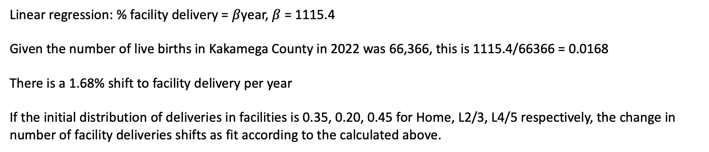
OVERVIEW OF ABM - Part 2: Simulation of scenarios
1. Trends in maternal mortality without intervention
We assume the natural decrease in maternal mortality over time is due to the shift to facility deliveries over time without intervention.
2. Distribution of deliveries at different facility levels
3. Effects of ANC visits
4. Effects of SDR on healthcare quality
5. DALY calculations
According to the Kenya MOH: # of facility births over time
2014 | 2015 | 2016 | 2017 | 2018 | 2019
38732 | 42717 | 43563 | 38334 | 45348 | 46007
Linear regression: % facility delivery = $β$year, $β$ = 1115.4
Given the number of live births in Kakamega County in 2022 was 66,366, this is 1115.4/66366 = 0.0168
There is a 1.68% shift to facility delivery per year
If the initial distribution of deliveries in facilities is 0.35, 0.20, 0.45 for Home, L2/3, L4/5 respectively, the change in number of facility deliveries shifts as fit according to the calculated above.

Slide 24
OVERVIEW OF ABM - Part 2: Simulation of scenarios
1. Trends in maternal mortality without intervention
We consider the following scenarios for shifts in deliveries.
2. Distribution of deliveries at different facility levels
2021 2022 2023 2024 2025
3. Effects of ANC visits
Percent births | Conservative
% of births at home | 0.35 | 0.35 | 0.35 | 0.33 | 0.30
% of births at L2/L3 facilities | 0.20 | 0.19 | 0.18 | 0.17 | 0.18
% of births at L4/L5 facilities | 0.45 | 0.45 | 0.47 | 0.50 | 0.53
4. Effects of SDR on healthcare quality
5. DALY calculations
Percent births | Moderate
% of births at home | 0.35 | 0.35 | 0.30 | 0.25 | 0.20
% of births at L2/L3 facilities | 0.20 | 0.18 | 0.18 | 0.15 | 0.12
% of births at L4/L5 facilities | 0.45 | 0.47 | 0.53 | 0.60 | 0.68
Percent births | Aggressive
% of births at home | 0.35 | 0.35 | 0.30 | 0.20 | 0.05
% of births at L2/L3 facilities | 0.20 | 0.16 | 0.11 | 0.04 | 0.05
% of births at L4/L5 facilities | 0.45 | 0.49 | 0.60 | 0.76 | 0.90

Slide 25
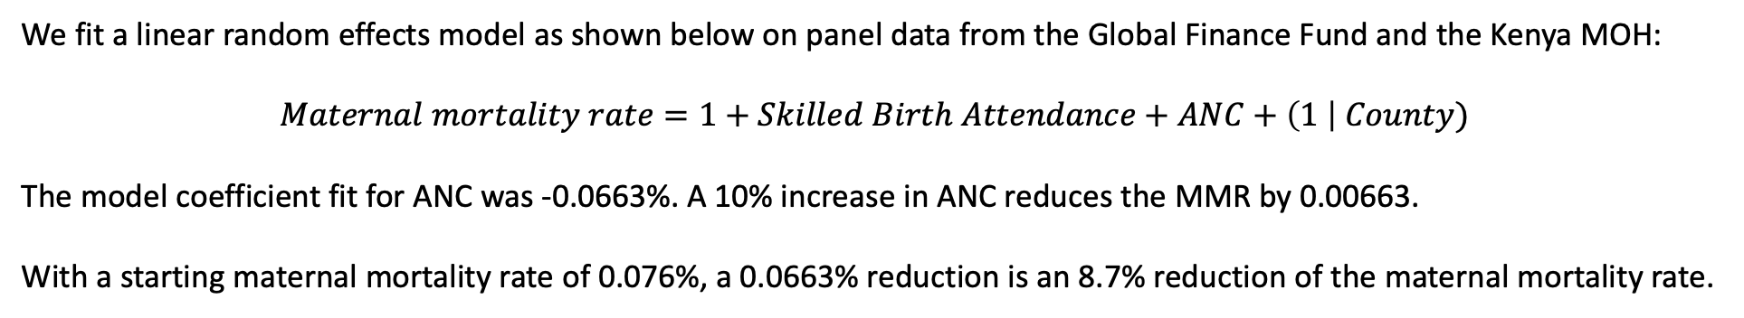
OVERVIEW OF ABM - Part 2: Simulation of scenarios
1. Trends in maternal mortality without intervention
We assume ANC reduces complications, so the calculated below is incorporated into the model as a reduction of complications by 8.7%.
2. Distribution of deliveries at different facility levels
3. Effects of ANC visits
4. Effects of SDR on healthcare quality
5. DALY calculations
We fit a linear random effects model as shown below on panel data from the Global Finance Fund and the Kenya MOH:
$$Maternal mortality rate=1+Skilled Birth Attendance+ANC+\left(1 \right| County)$$
The model coefficient fit for ANC was -0.0663%. A 10% increase in ANC reduces the MMR by 0.00663.
With a starting maternal mortality rate of 0.076%, a 0.0663% reduction is an 8.7% reduction of the maternal mortality rate.

Slide 26
OVERVIEW OF ABM - Part 2: Simulation of scenarios
1. Trends in maternal mortality without intervention
No current data on effects of SDR on healthcare quality, so assumption is that SDR reduces maternal mortality directly.
2. Distribution of deliveries at different facility levels
3. Effects of ANC visits
4. Effects of SDR on healthcare quality
5. DALY calculations

Slide 27
OVERVIEW OF ABM - Part 2: Simulation of scenarios
1. Trends in maternal mortality without intervention
2. Distribution of deliveries at different facility levels
3. Effects of ANC visits
4. Effects of SDR on healthcare quality
5. DALY calculations
DALY averted =
66 for maternal mortalities
21.77 for maternal near miss
Frequency of maternal near miss to maternal mortalities: 12.35:1
If 76.5 additional lives were saved because of a shift in deliveries according to the moderate scenario, 76.5*66 + 76.5*12.35*21.77 = 25,616 DALY averted

Slide 28
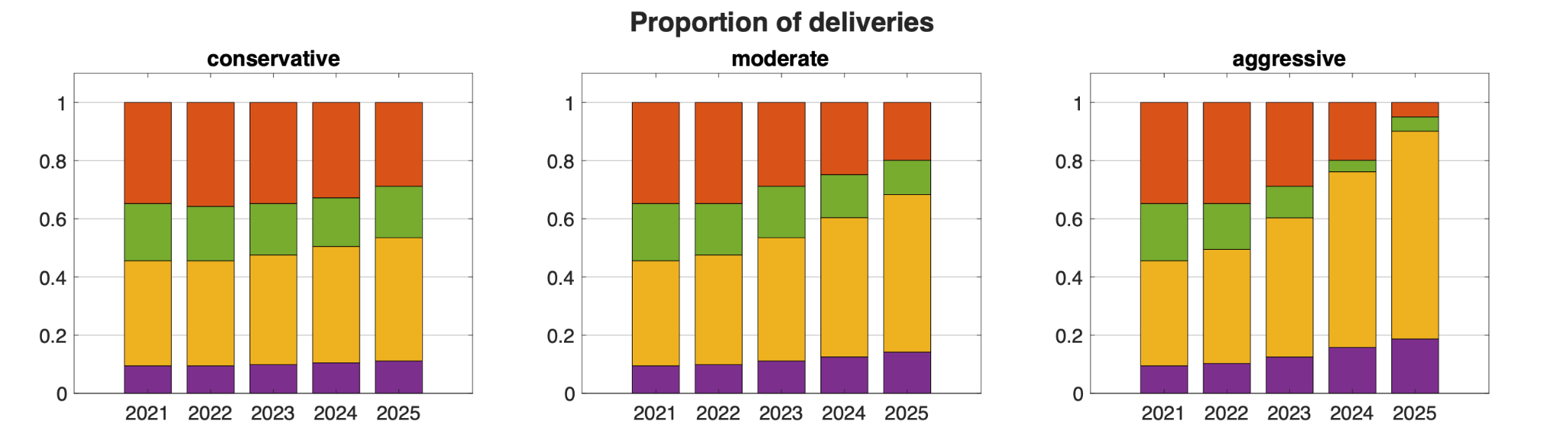
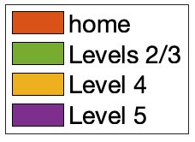
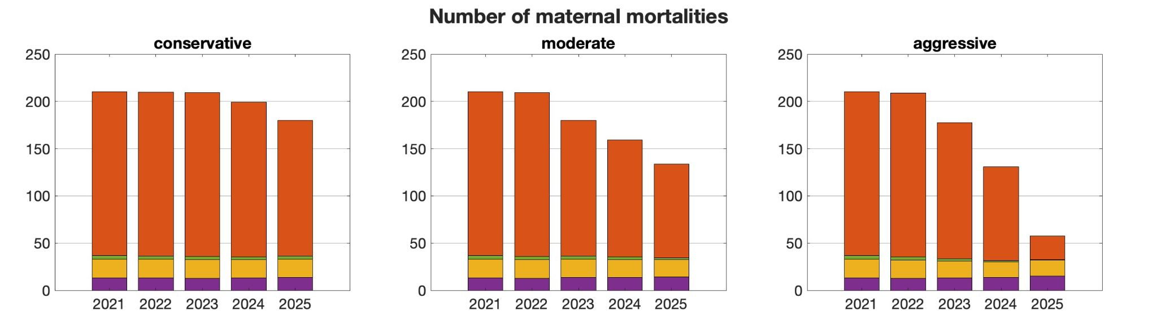
Scenario Outputs: Distribution of Deliveries and Maternal Mortalities [1,2]

Slide 29
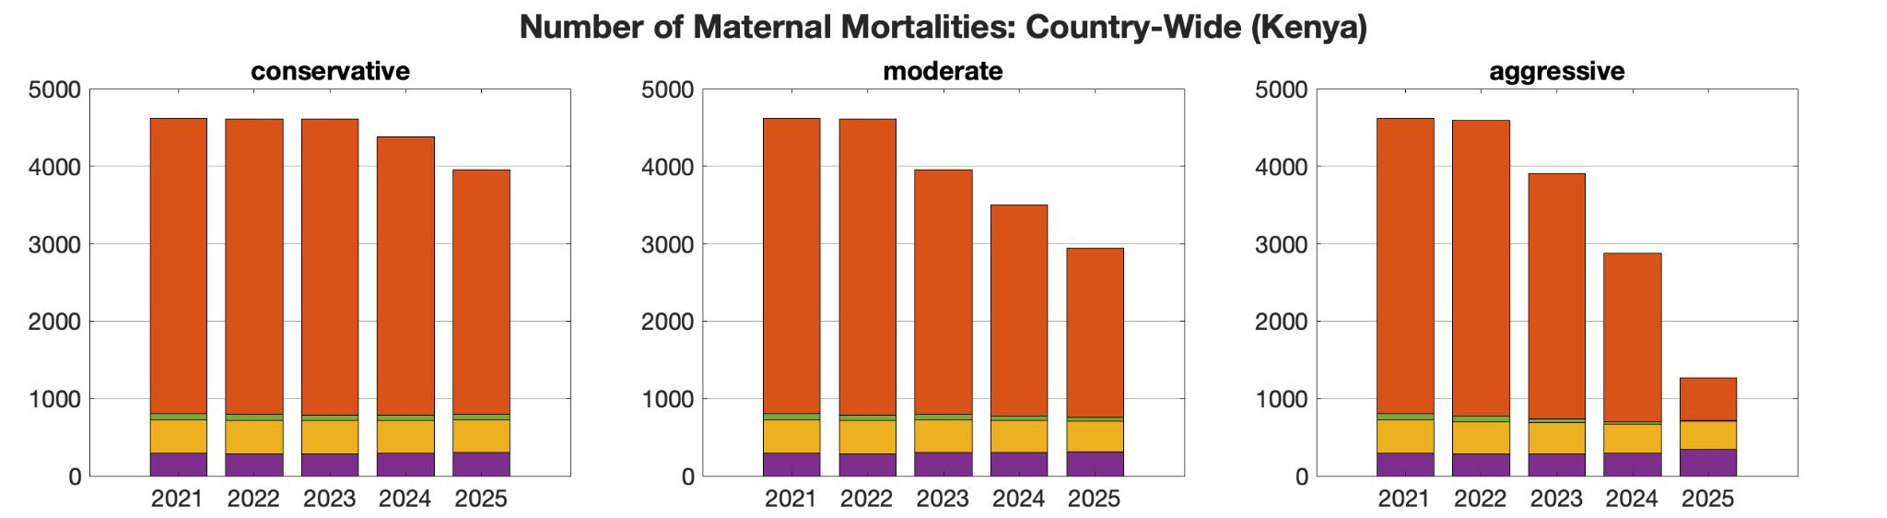
Scenario Outputs: Distribution of Deliveries and Maternal Mortalities, Extension to National Scale [1,2]

Slide 30
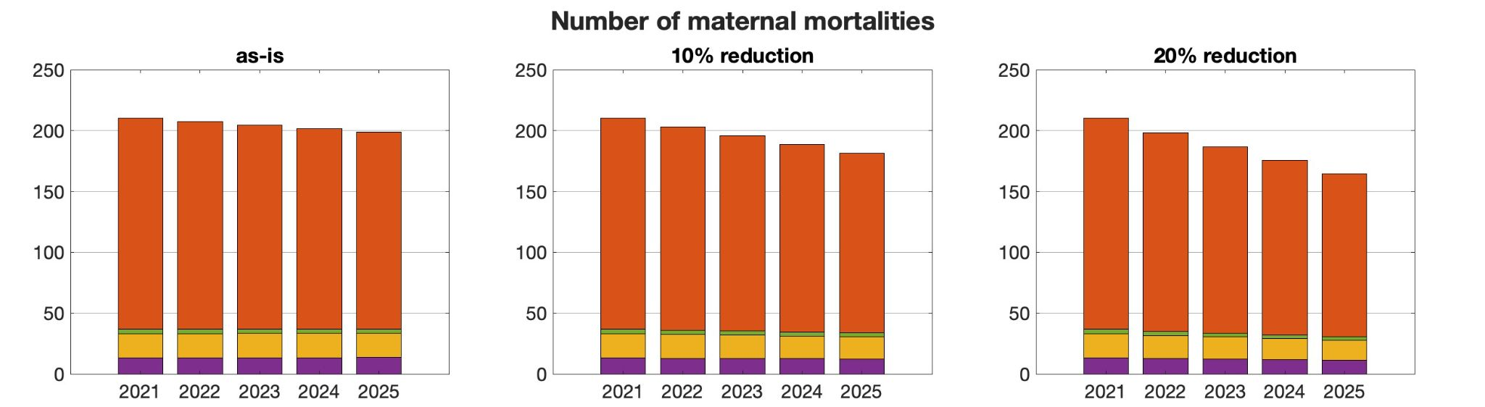
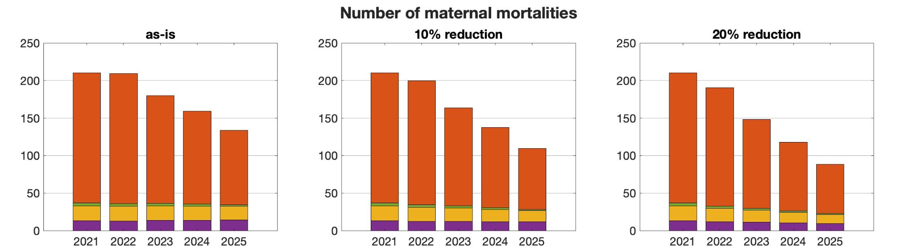
Scenario Outputs: Maternal Mortalities for no SDR and increased ANC effect compared to Maternal Mortalities with SDR and increased ANC effect [1,3 vs. 1,3,4]
No SDR + ANC effect
SDR + ANC effect

Slide 31
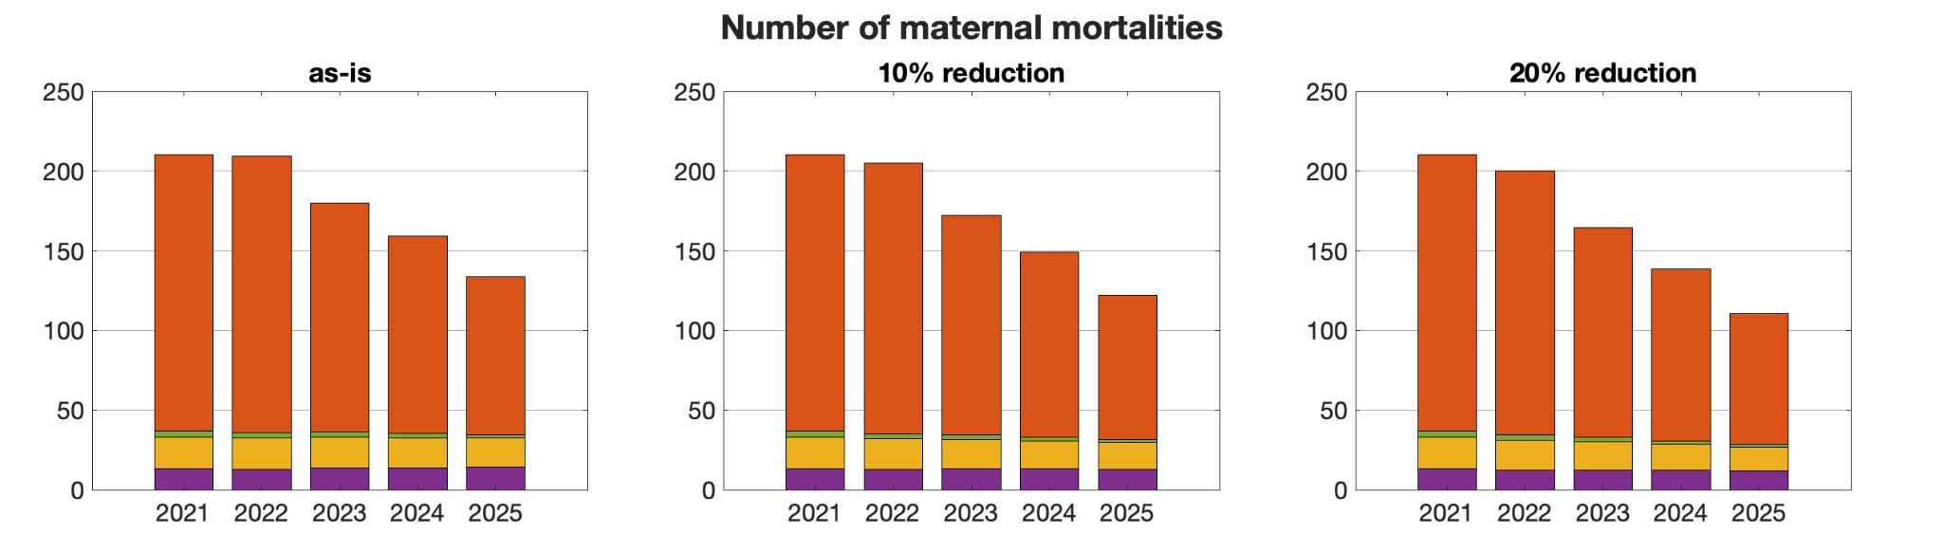
Scenario Outputs: Moderate SDR with Reduced Complications Due to Increased ANC Visits vs. Mortalities for Moderate SDR with Increased ANC Visits and SDR Impacts on Health Services Quality [1,2,3 vs. 1,2,3,4]
No SDR + ANC effect
SDR + ANC effect

Slide 32
Scenario Outputs: Cost of Sustaining SDR for each DALY Averted in Kakamega County, Kenya [5]
Scenario | DALYs averted | Cost per DALYs averted
 | Maternal mortalities and near-misses | KSh | USD
conservative | 10,103 | KSh 190,000 | $1541
moderate | 25,616 | KSh 80,000 | $645
aggressive | 51,112 | KSh 45,000 | $367

Slide 33
REVIEW OF ABM PART 2
We consider 4 scenarios and present the effects of the scenarios through our model using 2 outcome measures
Four scenarios:
Trends in maternal mortality without intervention
Changes in the distribution of deliveries at different facility levels
Changes in ANC behavior on reducing complications
Changes in healthcare quality because of SDR
Two outcome measures:
Maternal mortalities
Disability-adjusted life years averted

Slide 34
Linear Program Model

Slide 35




OVERVIEW OF ABM
Mother goes to antenatal care facility, where she is assessed for pregnancy risk.
Mother goes from antenatal care facility to her intended delivery facility.
Mother possibly develops complication during delivery
Mother is possibly transferred.
Mother’s transfer location is determined.
Mortality rates at facilities is determined.
5. New delivery facility
4. Referral
Health outcomes at facility
Pregnant mother
1. ANC facility
2. Initial delivery facility
3. Complication
Original delivery facility

Slide 36
STEP 1 OF ABM
Mother is assigned risk level at antenatal care facility according to the following distribution:
[0.33, 0.26, 0.41] → [0,1,2] where 0 = low risk, 1 = medium risk, 2 = high risk (1)
0
Low risk
0.33
0.26
1
Medium risk
0.41
2
High risk
https://bmjopen.bmj.com/content/12/1/e050670

Slide 37
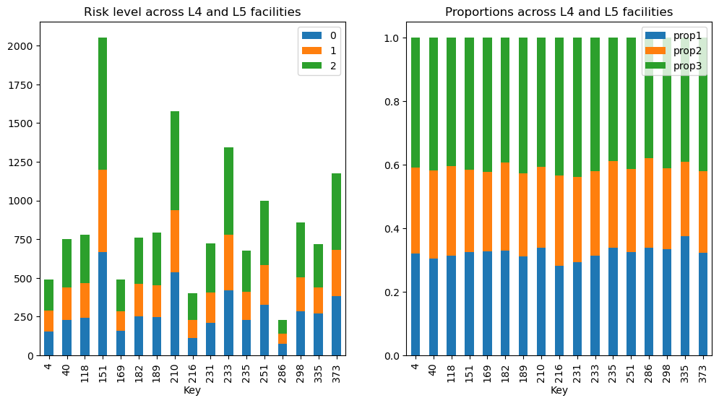
STEP 1 OF ABM
Mother is assigned risk level at antenatal care facility according to the following distribution:
[0.33, 0.26, 0.41] → [0,1,2] where 0 = low risk, 1 = medium risk, 2 = high risk (1)
Distribution of risk across subset of facilities
https://bmjopen.bmj.com/content/12/1/e050670

Slide 38
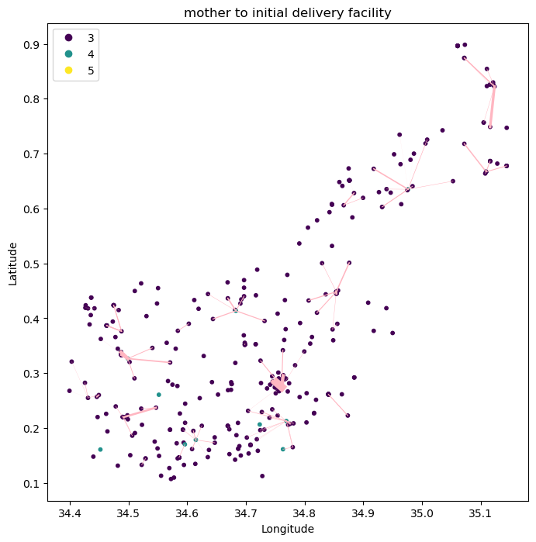
STEP 2 OF ABM
Mother is distributed from antenatal care facility to delivery facility with consideration for the following factors:
Distance to facility
Mother’s risk level and level of the facility
Capacity of the facility for EmONC (C-sections conducted)

Slide 39
STEP 3 OF ABM
3. Mother possibly develops complication from risk level according to the following distribution:
[0,1,2] → [0,0.02,0.07] → [0,1,2] where 0 = no complication, 1 = low complication, 2 = high complication
(low risk to complication : high risk to complication ~ 1:3 (2), 0.26*n + 0.41*3n = 0.035 (from data) n = 0.0235, 3n = 0.07, [0,1,2] → [0,n,3n] → [0,0.02,0.07] → [0,1,2]
Low risk
Med. risk
High risk
Assuming
41% high risk, 59% low-medium risk
- 100% of high risk at home = 41%
- ?% of low and medium risk
Assuming
Only medium risk can lead to complications
?*0.02=0.01 (risk of complication at home)
50% are medium risk, 50% are low risk
0
1
2
1
0.02
0.07
0
1
2
No comp.
Low comp.
High comp.
(2) https://www.ncbi.nlm.nih.gov/pmc/articles/PMC4728153/ U.S. ratio of low to high for eclampsia and uterine rupture is approximately 1:3

Slide 40
ABM Step 4
4. Mother is possibly transferred from Home to L4/5 given complication level according to the following:
[0,1,2] → [0,0.16,0.31] → [0,1] where 0 = not transferred, 1 = transferred
No comp.
0
0
No transfer
Low comp.
1
0.16
1
Transferred
2
0.31
High comp.

Slide 41
ABM Step 4
4. Mother is possibly transferred from L2/3 to L4/5 given complication level according to the following:
[0,1,2] → [0,0.5,1] → [0,1] where 0 = not transferred, 1 = transferred
No comp.
0
0
No transfer
Low comp.
1
Assume 50% are transferred
0.5
1
Transferred
2
1
High comp.
No deaths in L2/3 implies all high complications are transferred out

Slide 42
ABM Step 4
4. Mother is possibly transferred from L4 to L4/5 given complication level according to the following:
[0,1,2] → [0,0.21,0.42] → [0,1] where 0 = not transferred, 1 = transferred
No comp.
0
0
No transfer
Low comp.
1
0.21
1
Transferred
2
0.41
High comp.
0.21 and 0.41 based on transfer data
0.21:0.41 is based on previous slide on L2/3 transfers

Slide 43
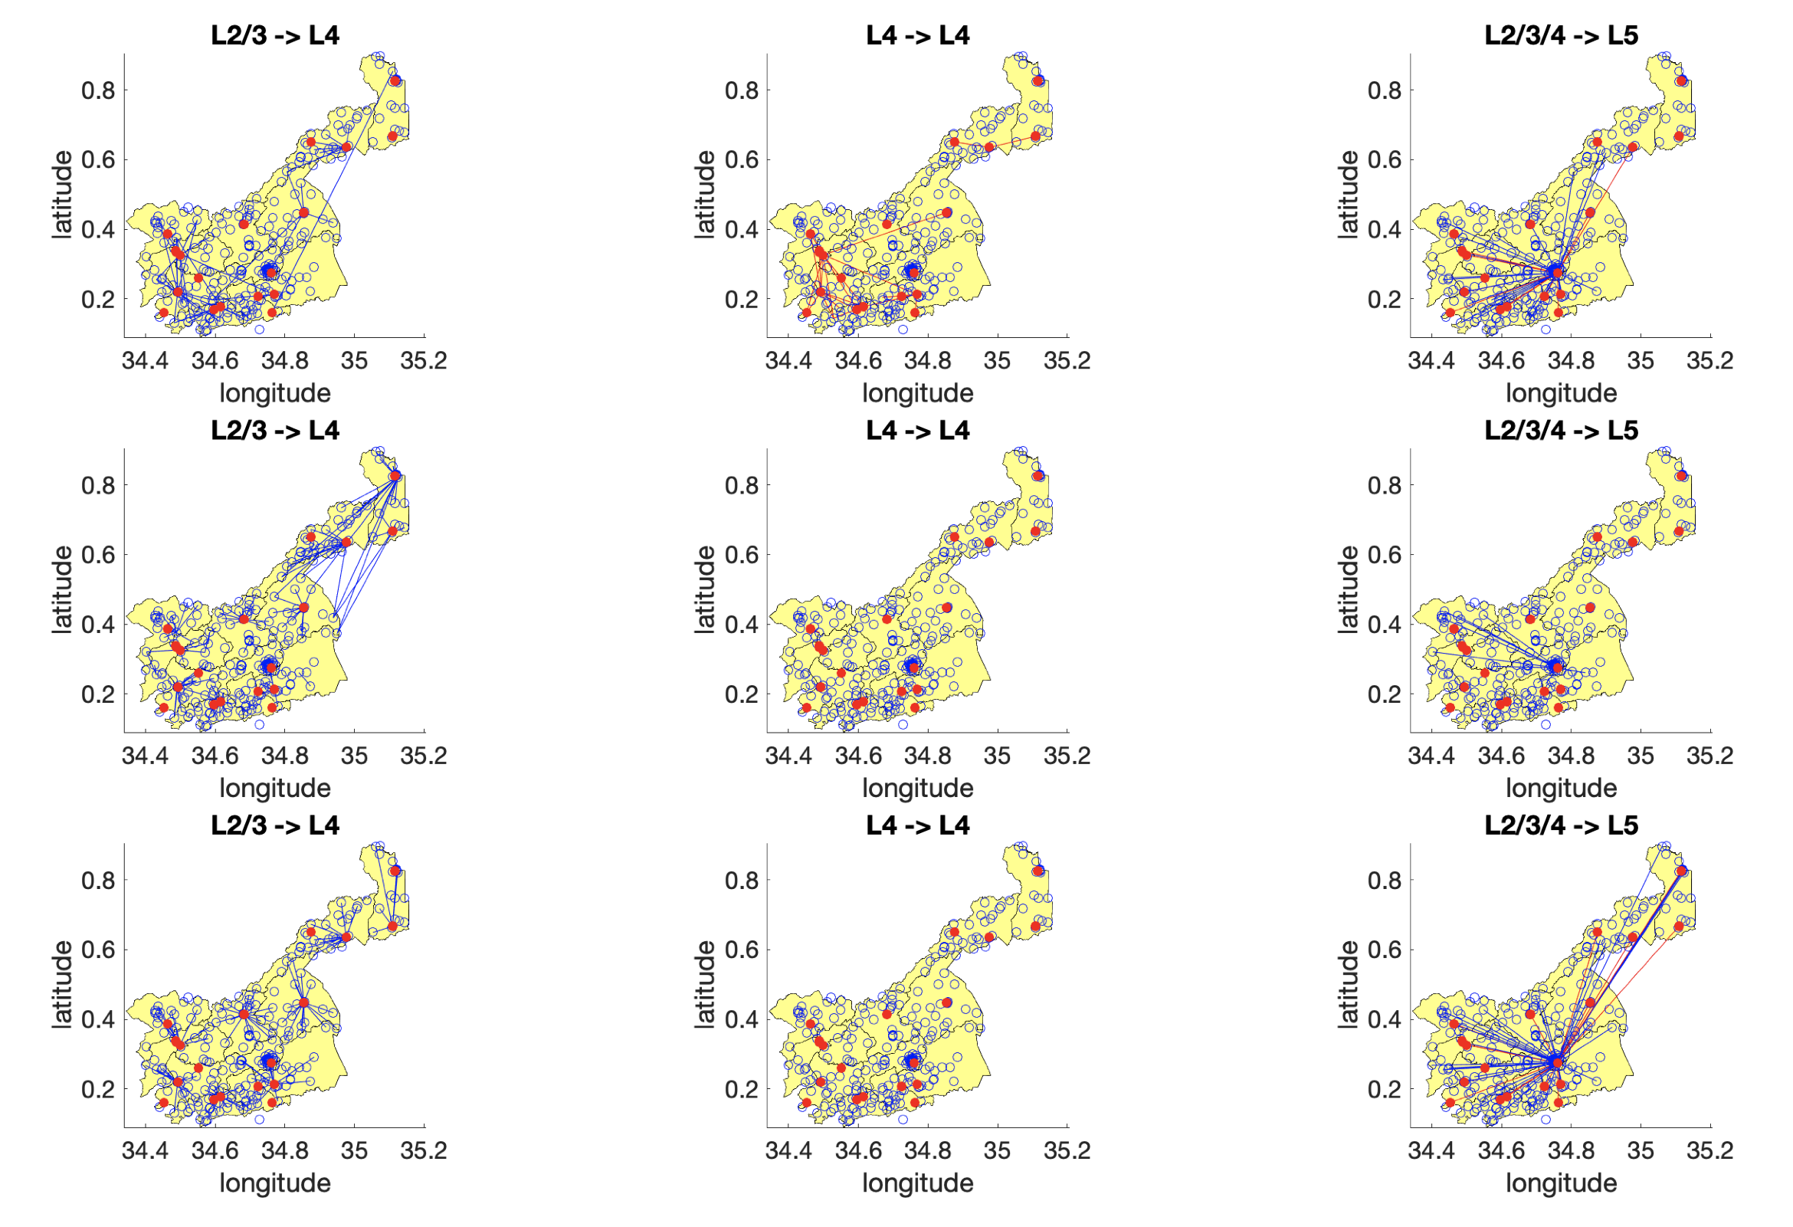
ABM Step 5
5. Mother, if referred, goes to the nearest L4 facility with EmONC capabilities or the L5 facility

Slide 44
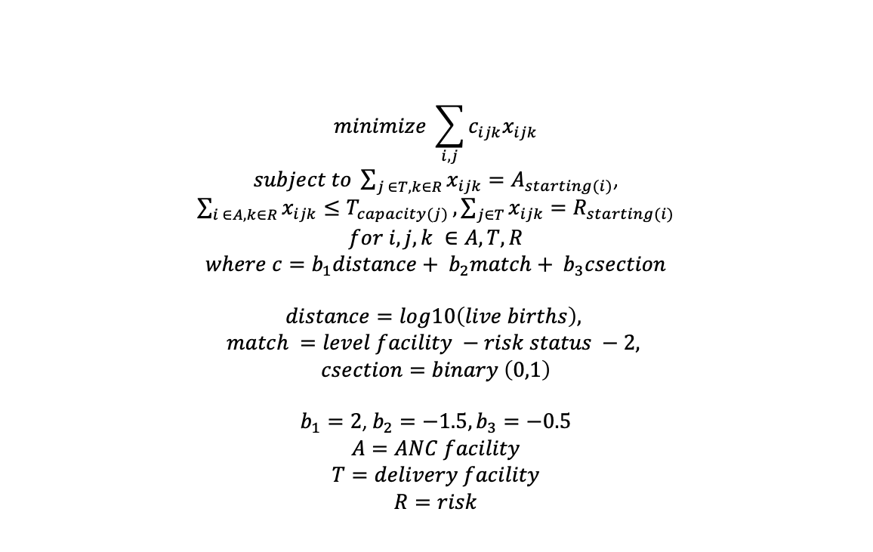
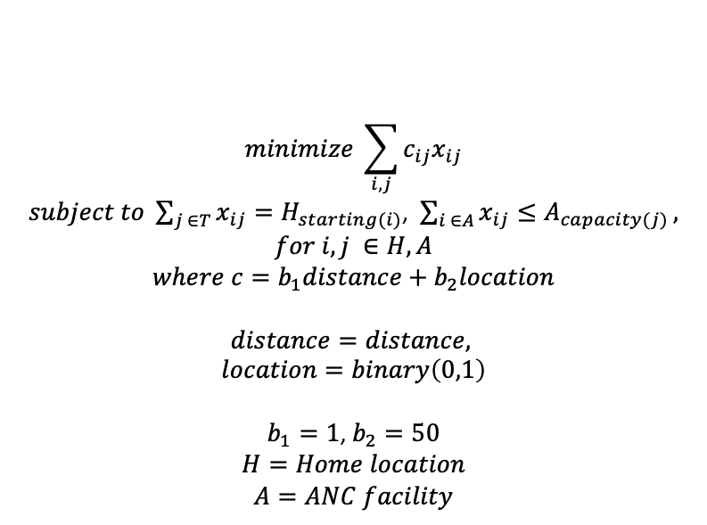
ABM Steps 2 - 5
Steps 2-5 (mothers travel to initial delivery facility, develop complication, are evaluated for transfer, and are transferred) are determined through the following LP, which matches the data reported from each of the facilities for:
Number of mothers who went to ANC for the first time
Number of live births
Number of complications
$$minimize \sum_{i,j}{c_{ij}x_{ij}}$$
$subject to \sum_{j ∈T}{x_{ij}=H_{starting(i)}}$, $\sum_{i ∈A}{x_{ij}≤A_{capacity(j)}},$
$$for i,j ∈H,A$$
$$where c=b_{1}distance+b_{2}location$$
$$distance=distance,$$
$$location=binary\left(0,1\right)$$
$b_{1}=1$, $b_{2}=50$
$$H=Home location$$
$$A=ANC facility$$
$$minimize \sum_{i,j}{c_{ijk}x_{ijk}}$$
$subject to \sum_{j ∈T,k∈R}{x_{ijk}=A_{starting(i)}}$, $\sum_{i ∈A,k∈R}{x_{ijk}≤T_{capacity(j)}},\sum_{j∈T}{x_{ijk}=R_{starting(i)}}$
$$for i,j,k ∈A,T,R$$
$$where c=b_{1}distance+ b_{2}match+ b_{3}csection$$
$$distance=log10\left(live births\right),$$
$$match =level facility −risk status −2,$$
$$csection=binary \left(0,1\right)$$
$b_{1}=2$, $b_{2}=−1.5,b_{3}=−0.5$
$$A=ANC facility$$
$$T=delivery facility$$
$$R=risk$$

Slide 45
STEP 6 OF ABM
6. Mortality rates at facilities is determined

Slide 46
Combined LP and Choice Model

Slide 47
OVERVIEW OF ABM
Mother goes to antenatal care facility, where she is assessed for pregnancy risk.
Mother goes from antenatal care facility to her intended delivery facility.
Mother possibly develops complication during delivery
Mother is possibly transferred.
Mother’s transfer location is determined.
Mortality rates at facilities is determined.
5. New delivery facility
4. Referral
Health outcomes at facility
Pregnant mother
1. ANC facility
2. Initial delivery facility
3. Complication
Original delivery facility

Slide 48
STEP 1 OF ABM
Mother is assigned risk level to ANC facility according to the following distribution:
[0.33, 0.26, 0.41] → [0,1,2] where 0 = low risk, 1 = medium risk, 2 = high risk (1)
0
Low risk
0.33
0.26
1
Medium risk
0.41
2
High risk
https://bmjopen.bmj.com/content/12/1/e050670 Kenya

Slide 49
STEP 1 OF ABM
Mother is assigned risk level at antenatal care facility according to the following distribution:
[0.33, 0.26, 0.41] → [0,1,2] where 0 = low risk, 1 = medium risk, 2 = high risk (1)
https://bmjopen.bmj.com/content/12/1/e050670

Slide 50
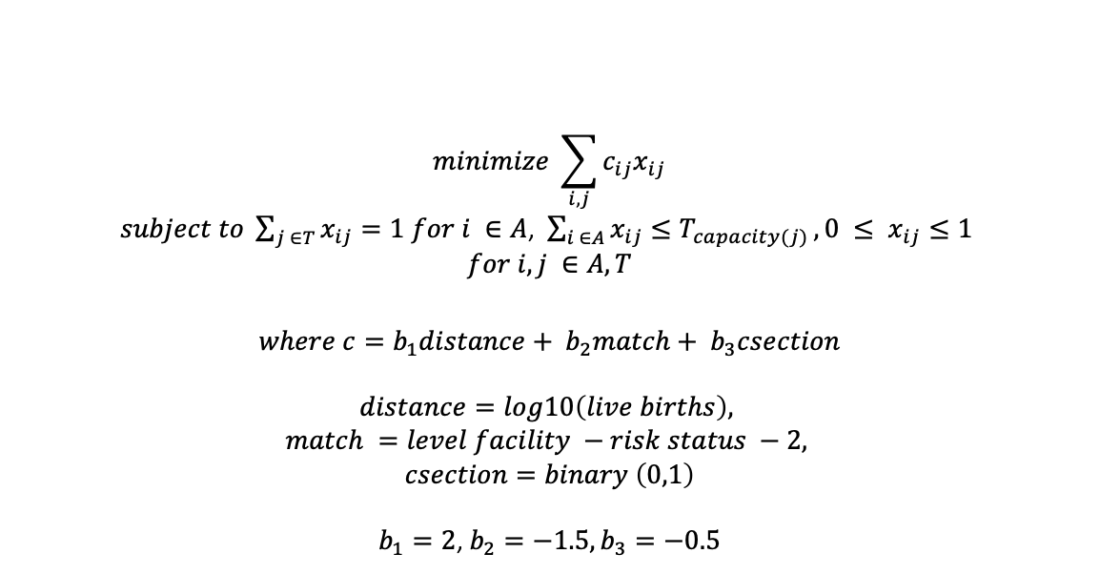
STEP 2 OF ABM
2. Mother is distributed from antenatal care facility to delivery facility according to the following LP
$$minimize \sum_{i,j}{c_{ij}x_{ij}}$$
$subject to \sum_{j ∈T}{x_{ij}=1 for i ∈A}$, $\sum_{i ∈A}{x_{ij}≤T_{capacity(j)}},0 ≤ x_{ij}≤1$
$$for i,j ∈A,T$$
$$where c=b_{1}distance+ b_{2}match+ b_{3}csection$$
$$distance=log10\left(live births\right),$$
$$match =level facility −risk status −2,$$
$$csection=binary \left(0,1\right)$$
$b_{1}=2$, $b_{2}=−1.5,b_{3}=−0.5$
Straight-line distance
All facilities
Distance to home is >> 1

Slide 51
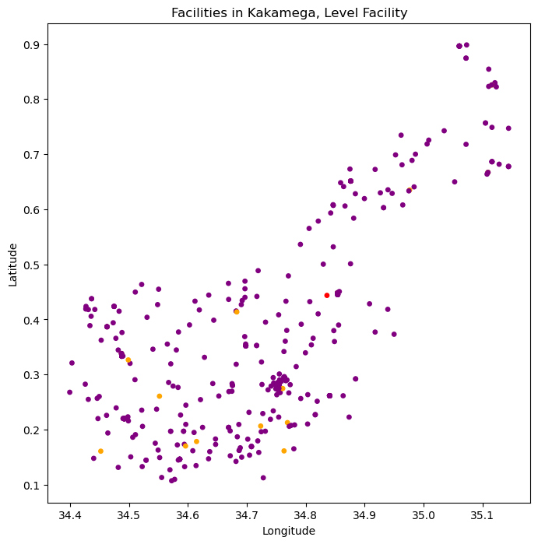
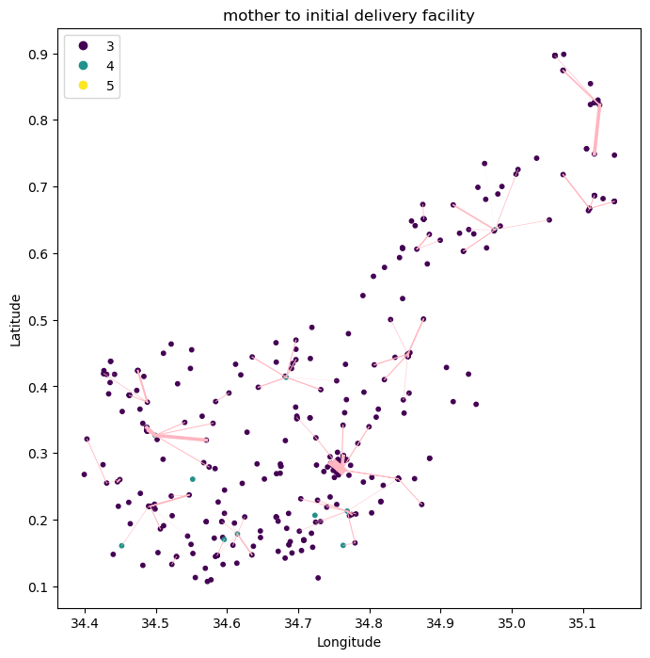
STEP 2 OF ABM
2. Mother is distributed from antenatal care facility to delivery facility according to the following LP

Slide 52
STEP 3 OF ABM
3. Mother possibly develops complication from risk level according to the following distribution:
[0,1,2] → [0,0.02,0.07] → [0,1,2] where 0 = no complication, 1 = low complication, 2 = high complication
(low risk to complication : high risk to complication ~ 1:3 (2), 0.26*n + 0.41*3n = 0.035 (from data) n = 0.0235, 3n = 0.07, [0,1,2] → [0,n,3n] → [0,0.02,0.07] → [0,1,2]
Low risk
Med. risk
High risk
0
1
2
1
0.02
0.07
0
1
2
No comp.
Low comp.
High comp.
(2) https://www.ncbi.nlm.nih.gov/pmc/articles/PMC4728153/ U.S. ratio of low to high for eclampsia and uterine rupture is approximately 1:3

Slide 53
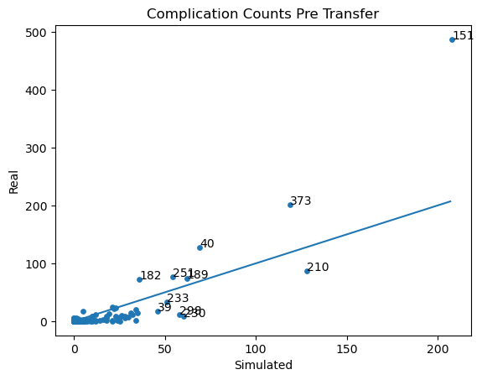
STEP 3 OF ABM
3. Mother possibly develops complication from risk level
Key | Pre-Transfer Simulated | Actual | Organization Name | Level Facility | Ratio
151 | 159.0 | 487.0 | Kakamega County General Hospital | 5.0 | 3.062893
40 | 49.0 | 128.0 | Butere Sub County Hospital | 4.0 | 2.612245
182 | 32.0 | 73.0 | Likuyani Sub-County Hospital | 4.0 | 2.281250
373 | 109.0 | 202.0 | St Mary's Hospital (Mumias) | 4.0 | 1.853211
189 | 52.0 | 74.0 | Lumakanda Sub County Hospital | 4.0 | 1.423077
169 | 23.0 | 25.0 | Khwisero Level IV Hospital | 4.0 | 1.086957
286 | 22.0 | 23.0 | Mwihila Mission Hospital | 4.0 | 1.045455
210 | 85.0 | 87.0 | Malava Sub County Hospital | 4.0 | 1.023529
251 | 94.0 | 77.0 | Mukumu Hospital | 4.0 | 0.819149
233 | 43.0 | 33.0 | Matungu Sub County Hospital | 4.0 | 0.767442
235 | 19.0 | 14.0 | Mautuma Sub County Hospital | 4.0 | 0.736842
231 | 28.0 | 20.0 | Matunda Sub County Hospital | 4.0 | 0.714286
118 | 28.0 | 12.0 | Iguhu Sub County Hospital | 4.0 | 0.428571
335 | 23.0 | 7.0 | Shibwe Sub-County Hospital | 4.0 | 0.304348
4 | 8.0 | 2.0 | Ahmadiya Hospital | 4.0 | 0.250000
298 | 51.0 | 12.0 | Navakholo Sub County Hospital | 4.0 | 0.235294
216 | 13.0 | 3.0 | Manyala Sub County Hospital | 4.0 | 0.230769
(2) https://www.ncbi.nlm.nih.gov/pmc/articles/PMC4728153/

Slide 54
STEP 3 OF ABM
3. Mother possibly develops complication from risk level
Key | Pre-Transfer Simulated | Actual | Organization Name | Level Facility | Ratio
151 | 159.0 | 487.0 | Kakamega County General Hospital | 5.0 | 3.062893
40 | 49.0 | 128.0 | Butere Sub County Hospital | 4.0 | 2.612245
182 | 32.0 | 73.0 | Likuyani Sub-County Hospital | 4.0 | 2.281250
373 | 109.0 | 202.0 | St Mary's Hospital (Mumias) | 4.0 | 1.853211
189 | 52.0 | 74.0 | Lumakanda Sub County Hospital | 4.0 | 1.423077
169 | 23.0 | 25.0 | Khwisero Level IV Hospital | 4.0 | 1.086957
286 | 22.0 | 23.0 | Mwihila Mission Hospital | 4.0 | 1.045455
210 | 85.0 | 87.0 | Malava Sub County Hospital | 4.0 | 1.023529
251 | 94.0 | 77.0 | Mukumu Hospital | 4.0 | 0.819149
233 | 43.0 | 33.0 | Matungu Sub County Hospital | 4.0 | 0.767442
235 | 19.0 | 14.0 | Mautuma Sub County Hospital | 4.0 | 0.736842
231 | 28.0 | 20.0 | Matunda Sub County Hospital | 4.0 | 0.714286
118 | 28.0 | 12.0 | Iguhu Sub County Hospital | 4.0 | 0.428571
335 | 23.0 | 7.0 | Shibwe Sub-County Hospital | 4.0 | 0.304348
4 | 8.0 | 2.0 | Ahmadiya Hospital | 4.0 | 0.250000
298 | 51.0 | 12.0 | Navakholo Sub County Hospital | 4.0 | 0.235294
216 | 13.0 | 3.0 | Manyala Sub County Hospital | 4.0 | 0.230769
These 4 have large differences from actual
Navakholo L4
Mumias L4
L5
Butere L4
(2) https://www.ncbi.nlm.nih.gov/pmc/articles/PMC4728153/

Slide 55
ABM Step 4
4. Mother is possibly transferred from L2/3 to L4/5 given complication level according to the following:
[0,1,2] → [0,0.5,1] → [0,1] where 0 = not transferred, 1 = transferred
No comp.
0
0
No transfer
Low comp.
1
Assume 50% are transferred
0.5
1
Transferred
2
1
High comp.
No deaths in L2/3 implies all high complications are transferred out

Slide 56
ABM Step 4
4. Mother is possibly transferred from L4 to L4/5 given complication level according to the following:
[0,1,2] → [0,0.21,0.42] → [0,1] where 0 = not transferred, 1 = transferred
No comp.
0
0
No transfer
Low comp.
1
0.21
1
Transferred
2
0.41
High comp.
0.21 and 0.41 based on transfer data
0.21:0.41 is based on previous slide on L2/3 transfers

Slide 57
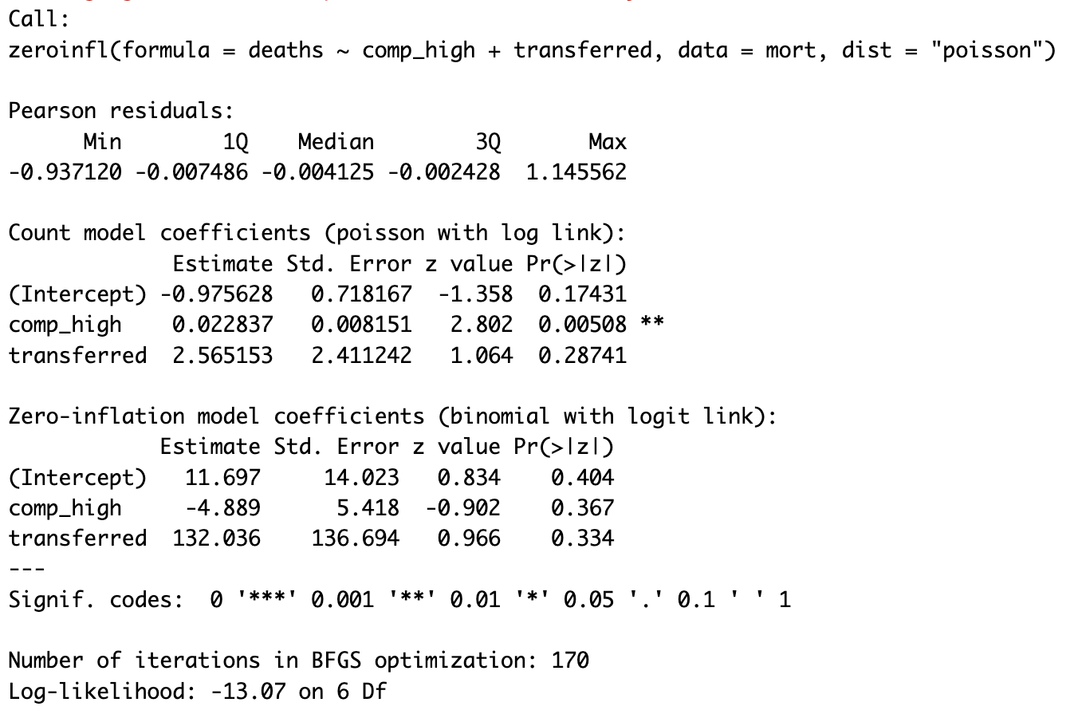
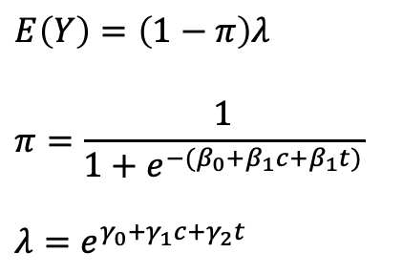
STEP 6 OF ABM
6. Mortality rates at facilities is determined using a zero-inflated Poisson model fit to the original mortality counts at the facility level.
The zero-inflated Poisson regression model includes two parts: a binary component that models the probability of observing a zero versus a non-zero value, and a Poisson component that models the count data for non-zero values.
$E\left(Y\right)=\left(1−π\right)λ$
$$π=\frac{1}{1+e^{−(β_{0}+β_{1}c+β_{1}t)}}$$
$$λ=e^{γ_{0}+γ_{1}c+γ_{2}t}$$
c = number of simulated high complication
t = number of simulated transfers
(level gave a singular result)

Slide 58
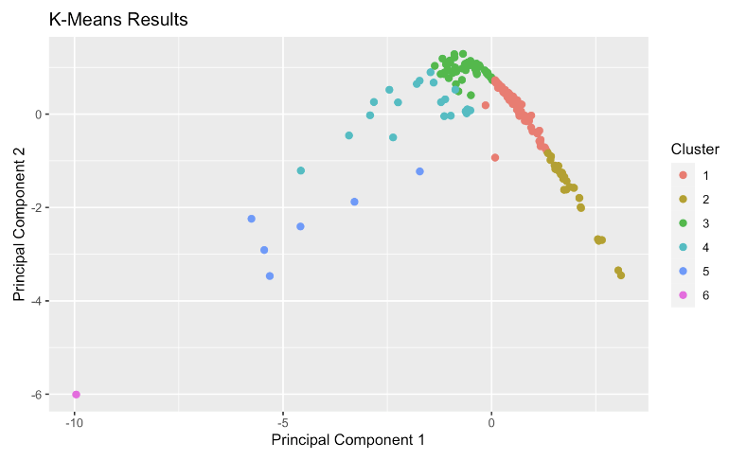
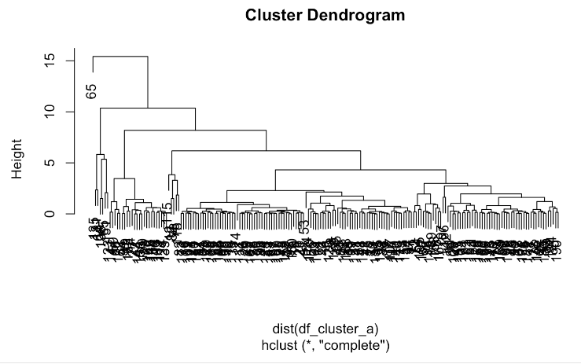
STEP 5 OF ABM
5. Mother’s location of transfer is determined by a conditional logit model, which allows for consideration of both the individual’s characteristics and the characteristics of the choices:
Part A: relabeling of facilities
Facilities are relabeled using hierarchical clustering, with label adjustments according to prior knowledge.
Characteristics used for clustering include:
Log10(Live birth)
Number of new ANC visits / live birth
C-section / live birth
Total complications / live birth
Number of maternal deaths / live birth
Ultimately, 6 clusters were chosen with a 7th cluster for facilities with no data
Notes:
Write it out (4)
Write out more clearly logic of (5)

Slide 59
STEP 5 OF ABM
5. Mother’s location of transfer is determined by a conditional logit model, which allows for consideration of both the individual’s characteristics and the characteristics of the choices:
Part A: relabeling of facilities
Facilities are relabeled using hierarchical clustering, with label adjustments according to prior knowledge.
Characteristics used for clustering include:
Log10(Live birth)
Number of new ANC visits / live birth
C-section / live birth
Total complications / live birth
Number of maternal deaths / live birth
Ultimately, 6 clusters were chosen with a 7th cluster for facilities with no data
Cluster 1: ~L4 facilities with c-section
Cluster 2: ~L4 facilities without c-section
Cluster 3: L5 facility
Cluster 4: L2/3 facilities Cluster 5: L2/3 facilities
Cluster 6: Level 3 facilities with c-section
Cluster 7: Facilities with no data
Notes:
Write it out (4)
Write out more clearly logic of (5)

Slide 60
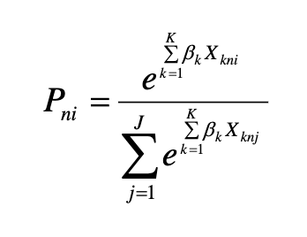
STEP 5 OF ABM
Conditioned on the covariates
5. Mother’s location of transfer is determined by a conditional logit model , which allows for consideration of both the individual’s characteristics and the characteristics of the choices:
n = individual
i = choice
k = predictor variable
j = other alternative
Part B: Defining the model
model.v1 <- mlogit(choice ~ Births | OriginCat + Complication | Distance, data = mcf_data)
Where for predictor variables:
log births is choice-general
original category and complication are individual-specific
distance is choice-specific
The three choices are
Choice 1: ~closest L4 facility with c-section (Cluster 1 facility)
Choice 2: ~closest L4 facility without c-section (Cluster 2 facility)
Choice 3: L5 facility (Cluster 3 facility)
Conditional probability of the choice of facility given that the mother will be transferred
Notes:
Write it out (4)
Write out more clearly logic of (5)

Slide 61
STEP 5 OF ABM
5. Mother’s location of transfer is determined by a conditional logit model , which allows for consideration of both the individual’s characteristics and the characteristics of the choices:
n = individual
i = choice
k = predictor variable
j = other alternative
Part B: Defining the model
model.v1 <- mlogit(choice ~ Births | OriginCat | Distance,
data = mcf_data)
Where for predictor variables:
births is choice-general
original category is individual-specific
distance is choice-specific
The three choices are
Choice 1: ~closest L4 facility with c-section (Cluster 1 facility)
Choice 2: ~closest L4 facility without c-section (Cluster 2 facility)
Choice 3: L5 facility (Cluster 3 facility)
Variable | Coefficient choice 1 | Coefficient choice 2 | Coefficient choice 3
Intercept | 0 | -3.84841 | 11.16878
Original Category 2, choice 1-3 | 0 | 14.98921 | -1.20340
Original Category 3, choice 1-3 | 0 | 17.45657 | -0.54457
Distance | 1.10211 | -2.42200 | -0.98061
DATA (Choice/Referrals.xlsx -> Simple + facility data): origin: cluster and level, individual: complication, for each choice: cluster, level, births, driving distance
Notes:
Write it out (4)
Write out more clearly logic of (5)

Slide 62
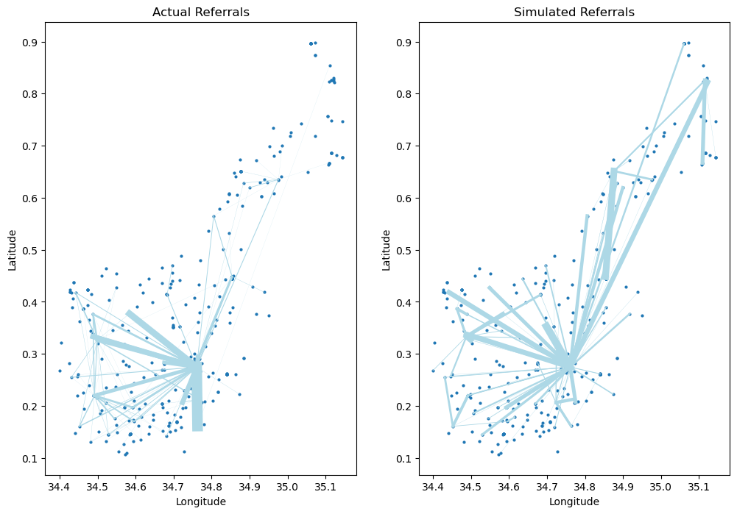
STEP 5 OF ABM
5. Mother’s location of transfer is determined by a conditional logit model
Actual referrals is referral data from one referral company, Rescue.co
Simulated referrals is generalized to represent all referrals.

Slide 63
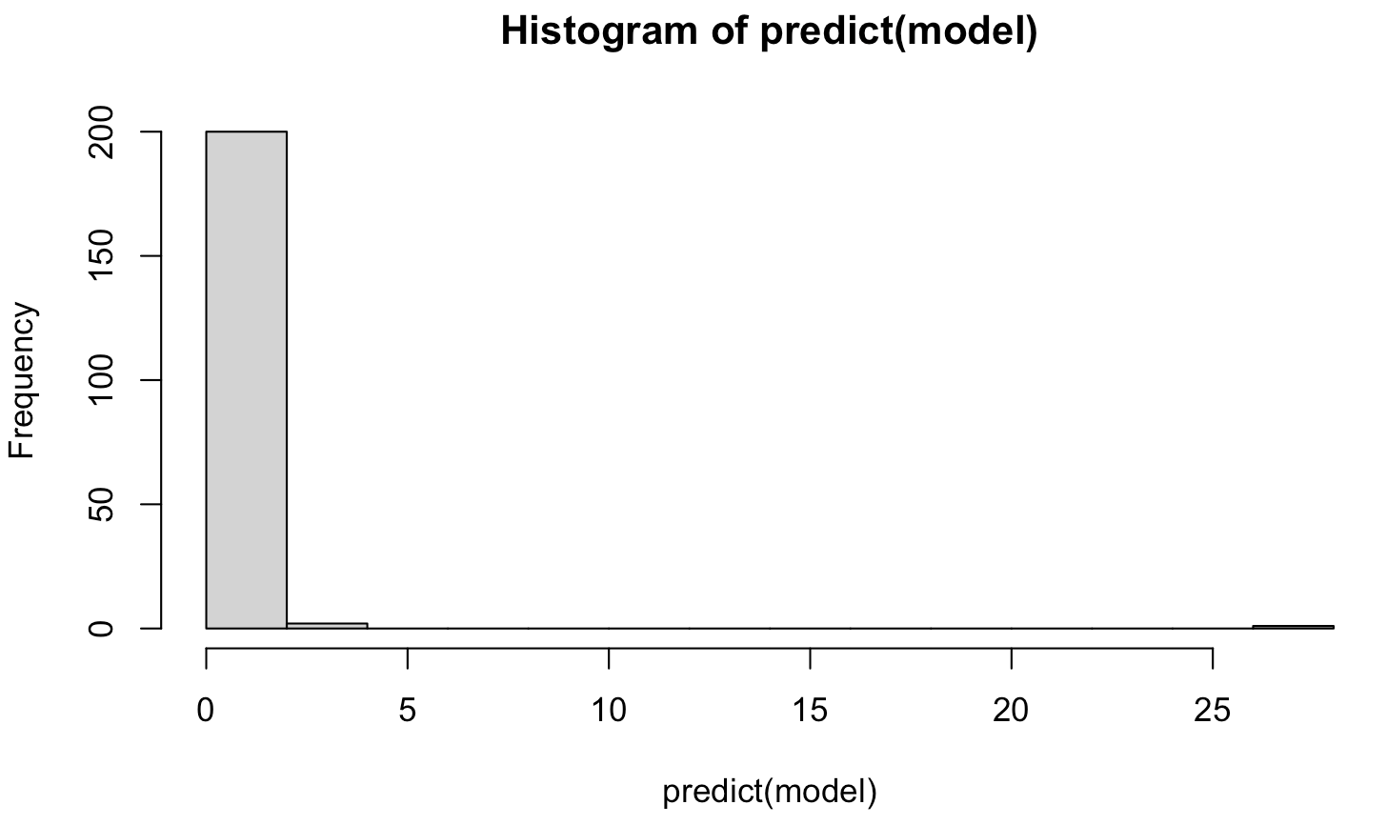
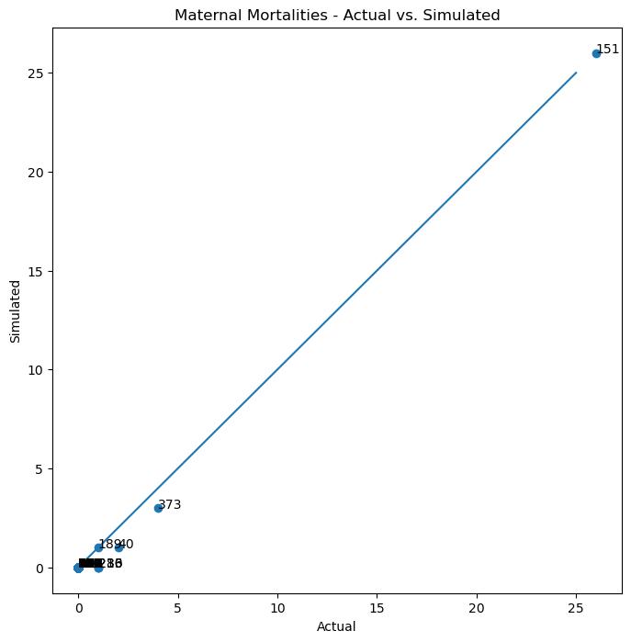
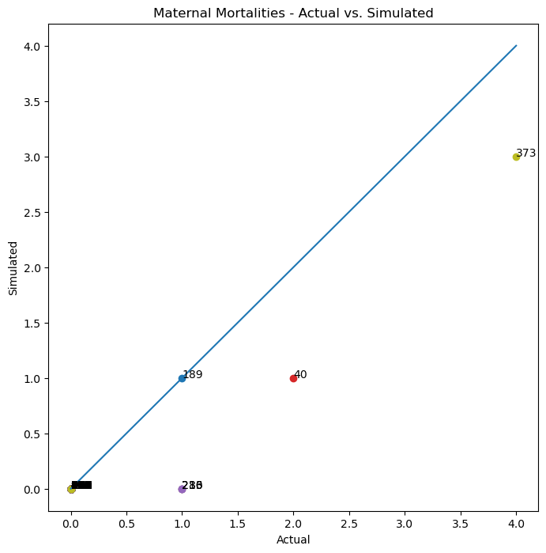
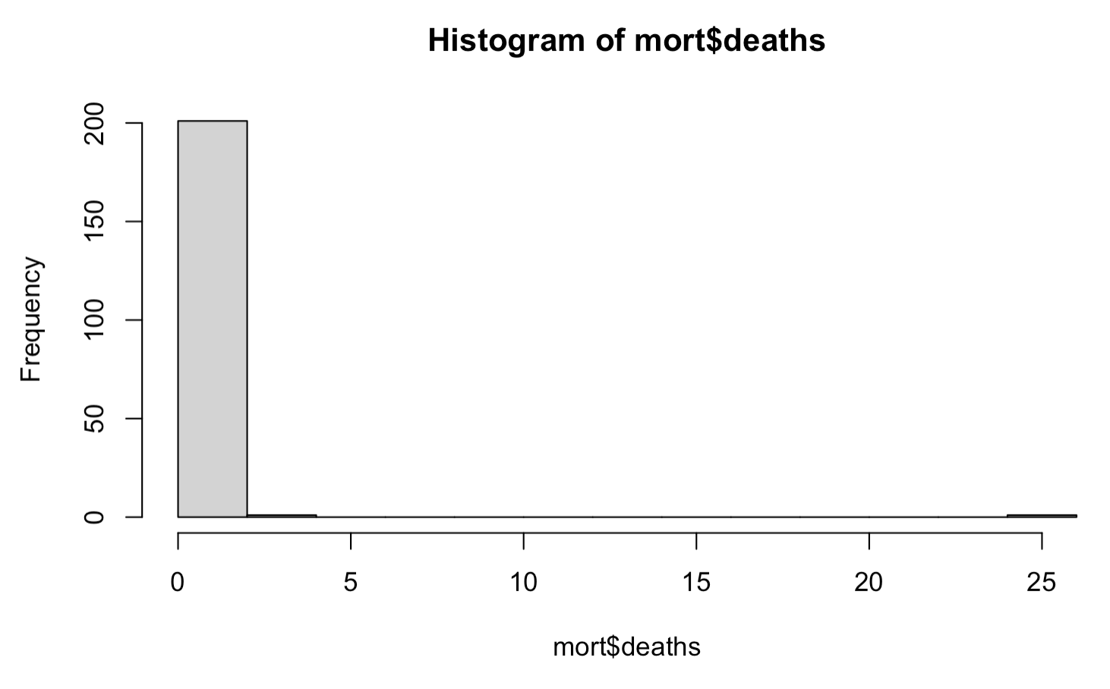
STEP 6 OF ABM
6. Mortality rates at facilities is determined using a zero-inflated Poisson model fit to the original mortality counts at the facility level.

Slide 64
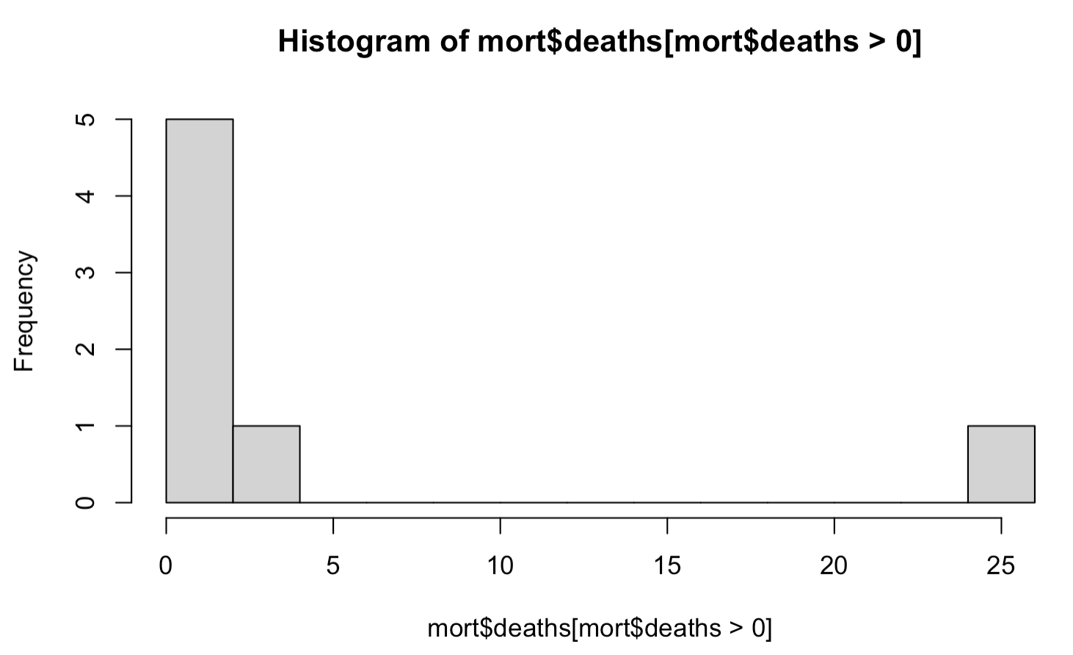
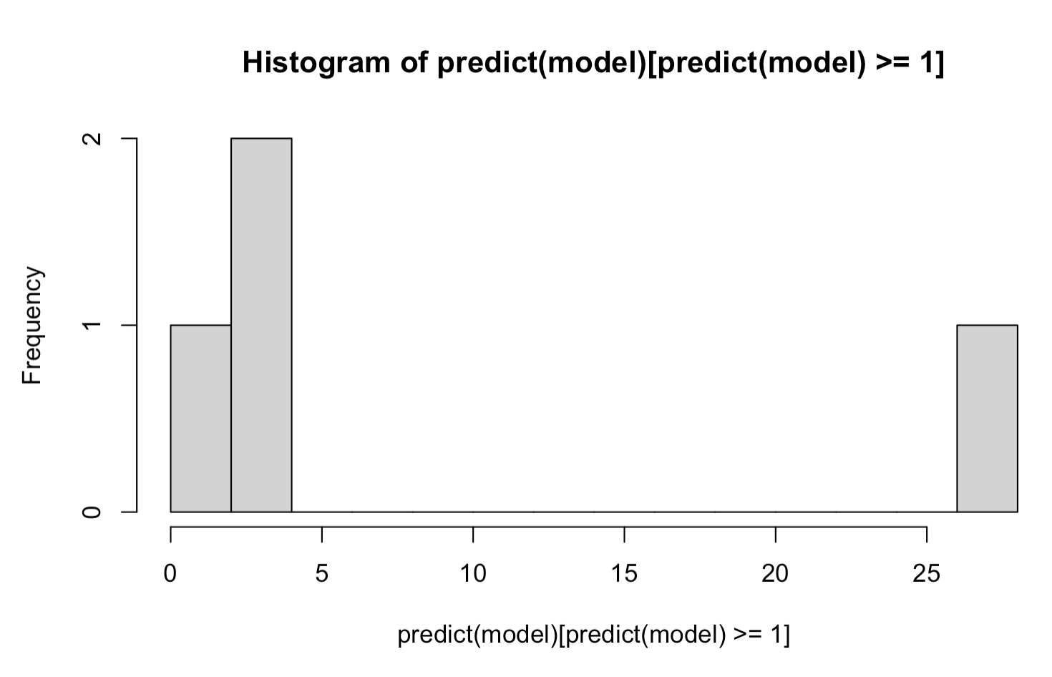
STEP 6 OF ABM
6. Mortality rates at facilities is determined using a zero-inflated Poisson model fit to the original mortality counts at the facility level.

Slide 65
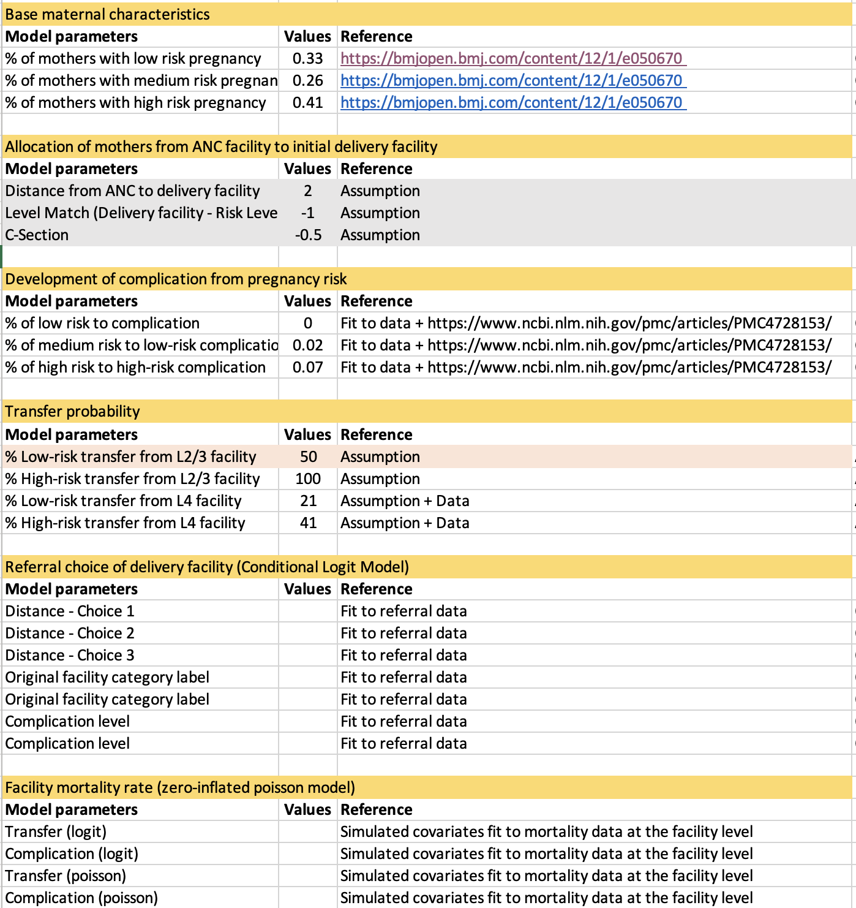
OVERVIEW OF MODEL PARAMETERS

Slide 66
ABM

Slide 67
OVERVIEW OF ABM - Part 1: Calibration and Validation
Transfer
(yes/no)
Mother’s initial choice of delivery
(Home, L2/3, L4, L5)
Mother’s final choice of delivery
(Home, L2/3, L4, L5)
Mother’s health outcome
Mother’s health status
(normal, low risk complication, high risk complication)

Slide 68
MOTHER’S INITIAL CHOICE OF DELIVERY FACILITY
L5
17377 (26%)
Aggregated from received facility data to the facility levels
Percentage of home births is approximated according to Nimako et al. 2018:
35% of births are at home
L4
20636 (31%)
L2/L3
5125
(8%)
Home
23228 (35%)
1. Mothers’ initial choice of delivery

Slide 69
SUBSET OF MOTHERS WITH COMPLICATIONS
L5
9.5%
Aggregated from received facility data to the facility levels
Percentage of complications at home is assumed to be the same as the overall percentage of complications across facilities (3.5%)
The complication rates are assumed to be final complication rates post transfer of mothers across facilities.
Mothers with complications
L4
3.8%
L2/L3
1.3%
Home
3.5%
2. Subset of mothers with complications

Slide 70
MOTHERS WITH COMPLICATIONS TRANSFERRED AND NOT TRANSFERRED
L5
9.5%
0.9%
2.6%
3.9%
2.2%
Mothers with complications
L4
3.8%
0.5%
2.1%
0.4%
1.3%
=
+
+
+
L2/L3
1.4%
0.0%
1.3%
0.0%
0.3%
Transferred mothers
Home
3.5%
0.6%
2.2%
high
low
high
low
2. Subset of mothers with complications
Not transferred
Transferred into

Slide 71
MOTHERS WITH COMPLICATIONS TRANSFERRED: Example of home transfers
Home
3.5%
← We assume 3.5% complications at home equal to overall complication rate across all facility levels.
?
?
L5
L5
?
L4
L4
← The overall complication rates at home will be equal to the complications left after transfer
?
L2/L3
?
L2/L3
?
Home
Home
low-severity
high-severity
complication transfers

Slide 72
MOTHERS WITH COMPLICATIONS TRANSFERRED: Example of home transfers
Home
3.5%
Referral data³ from Home
 | L2/3 | L4 | L5 | Total
high |  | 112 | 56 | 168
low | 57 | 37 |  | 94
?
?
L5
L5
From the referral data, we can see the distribution of transfers from home to the different facility levels
?
L4
L4
?
L2/L3
?
L2/L3
?
Home
Home
low-severity
high-severity
complication transfers

Slide 73
MOTHERS WITH COMPLICATIONS TRANSFERRED: Example of home transfers
Home
3.5%
Referral data³ from Home
 | L2/3 | L4 | L5 | Total
high |  | 112 | 56 | 168
low | 57 | 37 |  | 94
?
?
L5
L5
From the referral data, we can see the distribution of transfers from home to the different facility levels
?
We can attach these to percentages with assumptions:
3.6% of mothers who want to deliver at L2/3 are transferred
At L2/3 facilities, transfers occur for
100% of high-severity complications*
50% of low-severity complications*
1.1% of mothers who want to deliver at home are transferred
Proportionally, this is equal to
31% of high-severity complications
16% of low-severity complications
L4
L4
?
L2/L3
?
L2/L3
?
Home
Home
low-severity
high-severity
complication transfers

Slide 74
MOTHERS WITH COMPLICATIONS TRANSFERRED: Example of home transfers
Home
3.5%
Referral data³ from Home
 | L2/3 | L4 | L5 | Total
high |  | 112 | 56 | 168
low | 57 | 37 |  | 94
?
?
L5
L5
From the referral data, we can see the distribution of transfers from home to the different facility levels
?
We can attach these to percentages with assumptions:
3.6% of mothers who want to deliver at L2/3 are transferred
At L2/3 facilities, transfers occur for
100% of high-severity complications*
50% of low-severity complications*
1.1% of mothers who want to deliver at home are transferred
Proportionally, this is equal to
31% of high-severity complications
16% of low-severity complications
L4
L4
?
L2/L3
?
L2/L3
?
Home
Home
Percentage of transfers
 | L2/3 | L4 | L5 | Total
high |  | 21% | 10% | 31%
low | 10% | 6% |  | 16%
low-severity
high-severity
complication transfers

Slide 75
MOTHERS WITH COMPLICATIONS TRANSFERRED: Example of home transfers
Home
3.5%
Referral data³ from Home
We make additional assumptions that
75% of complications are low
25% of complications are high
Given that 3.5% of all births at home have complications, this is
0.75*0.035 = 0.009 (0.9%)
0.25*0.035 = 0.026 (2.6%)
 | L2/3 | L4 | L5 | Total
high |  | 112 | 56 | 168
low | 57 | 37 |  | 94
?
?
L5
L5
From the referral data, we can see the distribution of transfers from home to the different facility levels
?
We can attach these to percentages with assumptions:
3.6% of mothers who want to deliver at L2/3 are transferred
At L2/3 facilities, transfers occur for
100% of high-severity complications*
50% of low-severity complications*
1.1% of mothers who want to deliver at home are transferred
Proportionally, this is equal to
31% of high-severity complications
16% of low-severity complications
L4
L4
?
L2/L3
?
L2/L3
?
Home
Home
Percentage of transfers
 | L2/3 | L4 | L5 | Total
high |  | 21% | 10% | 31%
low | 10% | 6% |  | 16%
low-severity
high-severity
complication transfers

Slide 76
MOTHERS WITH COMPLICATIONS TRANSFERRED: Example of home transfers
Home
3.5%
Referral data³ from Home
We make additional assumptions that
75% of complications are low
25% of complications are high
Given that 3.5% of all births at home have complications, this is
0.75*0.035 = 0.009 (0.9%)
0.25*0.035 = 0.026 (2.6%)
31% of high-severity complications are transferred away
16% of low-severity complications are transferred away
This leaves
0.9%*(1-0.31) = 0.6%
2.6%*(1-0.16) = 2.2%
 | L2/3 | L4 | L5 | Total
high |  | 112 | 56 | 168
low | 57 | 37 |  | 94
?
?
L5
L5
From the referral data, we can see the distribution of transfers from home to the different facility levels
?
We can attach these to percentages with assumptions:
3.6% of mothers who want to deliver at L2/3 are transferred
At L2/3 facilities, transfers occur for
100% of high-severity complications*
50% of low-severity complications*
1.1% of mothers who want to deliver at home are transferred
Proportionally, this is equal to
31% of high-severity complications
16% of low-severity complications
L4
L4
?
L2/L3
?
L2/L3
?
Home
Home
Percentage of transfers
 | L2/3 | L4 | L5 | Total
high |  | 21% | 10% | 31%
low | 10% | 6% |  | 16%
low-severity
high-severity
complication transfers

Slide 77
MOTHERS WITH COMPLICATIONS TRANSFERRED: Example of home transfers
Home
3.5%
Referral data³ from Home
We make additional assumptions that
75% of complications are low
25% of complications are high
Given that 3.5% of all births at home have complications, this is
0.75*0.035 = 0.009 (0.9%)
0.25*0.035 = 0.026 (2.6%)
31% of high-severity complications are transferred away
16% of low-severity complications are transferred away
This leaves
0.9%*(1-0.31) = 0.6%
2.6%*(1-0.16) = 2.2%
 | L2/3 | L4 | L5 | Total
high |  | 112 | 56 | 168
low | 57 | 37 |  | 94
0.6
2.2
L5
L5
From the referral data, we can see the distribution of transfers from home to the different facility levels
10%
We can attach these to percentages with assumptions:
3.6% of mothers who want to deliver at L2/3 are transferred
At L2/3 facilities, transfers occur for
100% of high-severity complications*
50% of low-severity complications*
1.1% of mothers who want to deliver at home are transferred
Proportionally, this is equal to
31% of high-severity complications
16% of low-severity complications
L4
L4
6%
L2/L3
21%
L2/L3
10%
Home
Home
3.5%
0.6
2.2
Percentage of transfers
Not transferred
 | L2/3 | L4 | L5 | Total
high |  | 21% | 10% | 31%
low | 10% | 6% |  | 16%
low-severity
high-severity
complication transfers
0.3
0.4
Transferred out
high
low

Slide 78
HEALTH OUTCOMES FOR MOTHERS
0.273%
2.1%
0.9%
3
2.1%
3.9%
0.1%
2.6%
3
0.1%
2.2%
L5
0.087%
4.9%
0.5%
4.9%
0.4%
0.3%
2.1%
0.3%
1.3%
L4
=
+
+
+
0.006%
15%
0.0%
15%
0.0%
1%
1.3%
1%
0.3%
L2/3
0.750%
100%
0.6%
100%
% high
6.5%
2.2%
6.5%
% low
Home
Overall maternal mortality rates
MMR for high complications
% high
MMR for high complications
MMR for low complications
% low
MMR for low complications
Not transferred
Transferred
Not transferred
Transferred

Slide 79
REVIEW OF ABM PART 1
The model models pathways of the maternal care continuum in Kakamega County, Kenya, considering four components:
Choice of delivery facility
Mother’s health status
Transfer of mothers because of health status
Maternal mortality
Several parameters were required in the model, but not in the recorded data:
Proportion of low and high complications
Proportion of transferred and not transferred complications given severity
Mortality rates at facility levels
The effect of transfers on mortality rates
These parameters were calibrated by matching the recorded rates below with the rates determined by the model
Delivery at facility levels
Complications at facility levels
Mortality rates at facility levels

Slide 80
OVERVIEW OF ABM - Part 2: Simulation of scenarios
1. Trends in maternal mortality without intervention
2. Distribution of deliveries at different facility levels
3. Effects of ANC visits
4. Effects of SDR on healthcare quality
5. DALY calculations

Slide 81
OVERVIEW OF ABM - Part 2: Simulation of scenarios
1. Trends in maternal mortality without intervention
We assume the natural decrease in maternal mortality over time is due to the shift to facility deliveries over time without intervention.
2. Distribution of deliveries at different facility levels
3. Effects of ANC visits
4. Effects of SDR on healthcare quality
5. DALY calculations
According to the Kenya MOH: # of facility births over time
2014 | 2015 | 2016 | 2017 | 2018 | 2019
38732 | 42717 | 43563 | 38334 | 45348 | 46007
Linear regression: % facility delivery = $β$year, $β$ = 1115.4
Given the number of live births in Kakamega County in 2022 was 66,366, this is 1115.4/66366 = 0.0168
There is a 1.68% shift to facility delivery per year
If the initial distribution of deliveries in facilities is 0.35, 0.20, 0.45 for Home, L2/3, L4/5 respectively, the change in number of facility deliveries shifts as fit according to the calculated above.

Slide 82
OVERVIEW OF ABM - Part 2: Simulation of scenarios
1. Trends in maternal mortality without intervention
We consider the following scenarios for shifts in deliveries.
2. Distribution of deliveries at different facility levels
2021 2022 2023 2024 2025
3. Effects of ANC visits
Percent births | Conservative
% of births at home | 0.35 | 0.35 | 0.35 | 0.33 | 0.30
% of births at L2/L3 facilities | 0.20 | 0.19 | 0.18 | 0.17 | 0.18
% of births at L4/L5 facilities | 0.45 | 0.45 | 0.47 | 0.50 | 0.53
4. Effects of SDR on healthcare quality
5. DALY calculations
Percent births | Moderate
% of births at home | 0.35 | 0.35 | 0.30 | 0.25 | 0.20
% of births at L2/L3 facilities | 0.20 | 0.18 | 0.18 | 0.15 | 0.12
% of births at L4/L5 facilities | 0.45 | 0.47 | 0.53 | 0.60 | 0.68
Percent births | Aggressive
% of births at home | 0.35 | 0.35 | 0.30 | 0.20 | 0.05
% of births at L2/L3 facilities | 0.20 | 0.16 | 0.11 | 0.04 | 0.05
% of births at L4/L5 facilities | 0.45 | 0.49 | 0.60 | 0.76 | 0.90

Slide 83
OVERVIEW OF ABM - Part 2: Simulation of scenarios
1. Trends in maternal mortality without intervention
We assume ANC reduces complications, so the calculated below is incorporated into the model as a reduction of complications by 8.7%.
2. Distribution of deliveries at different facility levels
3. Effects of ANC visits
4. Effects of SDR on healthcare quality
5. DALY calculations
We fit a linear random effects model as shown below on panel data from the Global Finance Fund and the Kenya MOH:
$$Maternal mortality rate=1+Skilled Birth Attendance+ANC+\left(1 \right| County)$$
The model coefficient fit for ANC was -0.0663%. A 10% increase in ANC reduces the MMR by 0.00663.
With a starting maternal mortality rate of 0.076%, a 0.0663% reduction is an 8.7% reduction of the maternal mortality rate.

Slide 84
OVERVIEW OF ABM - Part 2: Simulation of scenarios
1. Trends in maternal mortality without intervention
No current data on effects of SDR on healthcare quality, so assumption is that SDR reduces maternal mortality directly.
2. Distribution of deliveries at different facility levels
3. Effects of ANC visits
4. Effects of SDR on healthcare quality
5. DALY calculations

Slide 85
OVERVIEW OF ABM - Part 2: Simulation of scenarios
1. Trends in maternal mortality without intervention
2. Distribution of deliveries at different facility levels
3. Effects of ANC visits
4. Effects of SDR on healthcare quality
5. DALY calculations
DALY averted =
66 for maternal mortalities
21.77 for maternal near miss
Frequency of maternal near miss to maternal mortalities: 12.35:1
If 76.5 additional lives were saved because of a shift in deliveries according to the moderate scenario, 76.5*66 + 76.5*12.35*21.77 = 25,616 DALY averted

Slide 86
Scenario Outputs: Distribution of Deliveries and Maternal Mortalities [1,2]

Slide 87
Scenario Outputs: Distribution of Deliveries and Maternal Mortalities, Extension to National Scale [1,2]

Slide 88
Scenario Outputs: Moderate SDR with Reduced Complications Due to Increased ANC Visits vs. Mortalities for Moderate SDR with Increased ANC Visits and SDR Impacts on Health Services Quality [1,2,3 vs. 1,2,3,4]
No SDR + ANC effect
SDR + ANC effect

Slide 89
Scenario Outputs: Cost of Sustaining SDR for each DALY Averted in Kakamega County, Kenya [5]
Scenario | DALYs averted | Cost per DALYs averted
 | Maternal mortalities and near-misses | KSh | USD
conservative | 10,103 | KSh 190,000 | $1541
moderate | 25,616 | KSh 80,000 | $645
aggressive | 51,112 | KSh 45,000 | $367

Slide 90
REVIEW OF ABM PART 2
We consider 4 scenarios and present the effects of the scenarios through our model using 2 outcome measures
Four scenarios:
Trends in maternal mortality without intervention
Changes in the distribution of deliveries at different facility levels
Changes in ANC behavior on reducing complications
Changes in healthcare quality because of SDR
Two outcome measures:
Maternal mortalities
Disability-adjusted life years averted

